Slide 1
Industry and Westward Expansion
The American Pageant,
Chapter 24

Slide 2
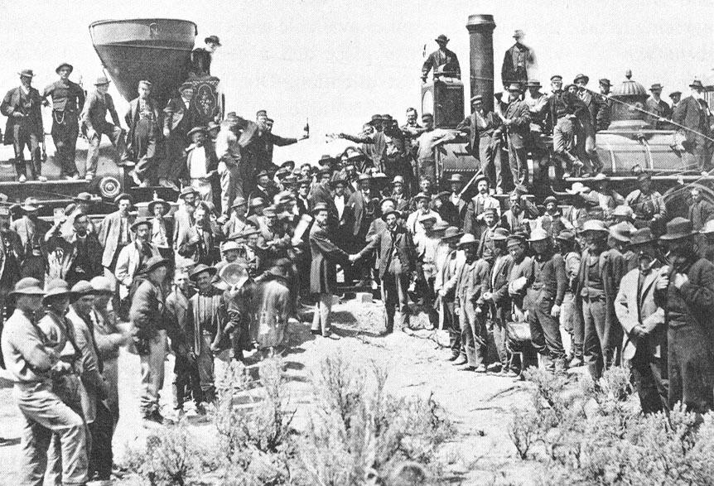
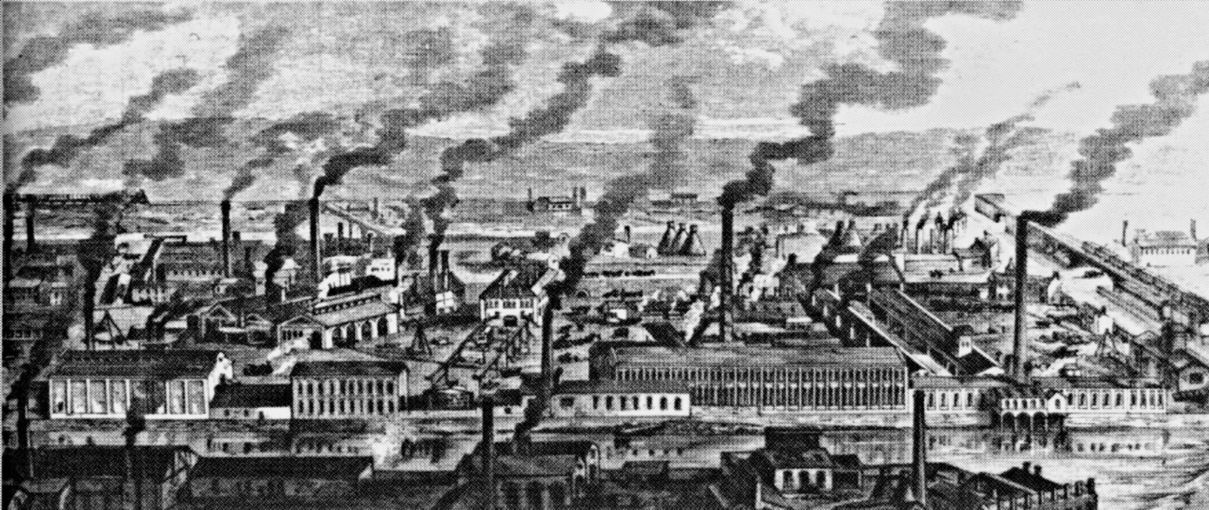
New Industrial Revolution
1900—USA is leading industrial power in the world
Impacts the country economically, socially, politically
Manufacturing replaces “king cotton” as the money maker
Rise of big business**
Increase in immigration**
Transition to an urbanization**
Pros and Cons

Slide 3
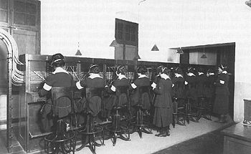
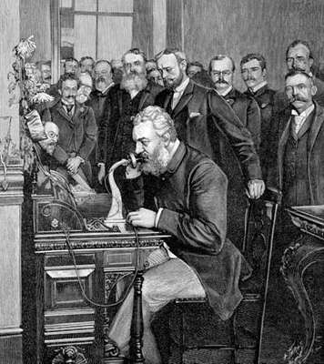
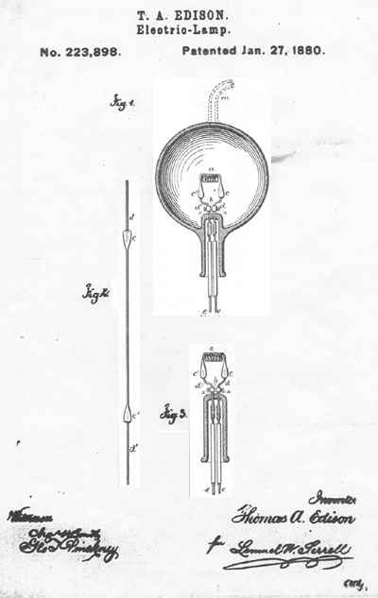
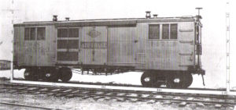
Inventions and Innovations
Increase of inventions and patents
Alexander Graham Bell
Thomas Edison**
Consequences of inventions
Changes daily lives
Creates jobs
Social consequences—good and bad**

Slide 4
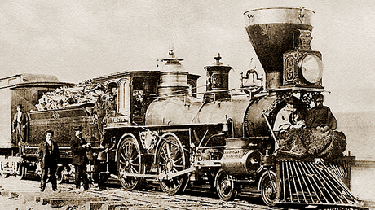
First Big Business-Rail Road
Federal government loans land and money to companies
BUT—government is largely “laissez-faire”, so…why?
RR companies establish new practices
Stockholding, management, financing, etc.
Key word to know—regulation**
Growth of RR → consolidation and standardization of industry
Steel**
Efficiency**

Slide 5
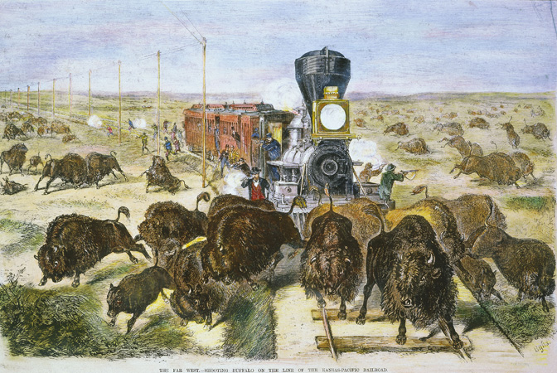
Westward Expansion
As the railroad expands, so do we
Conflict—Native Americans
Dawes Act**
Homestead Act, 1862**

Slide 6
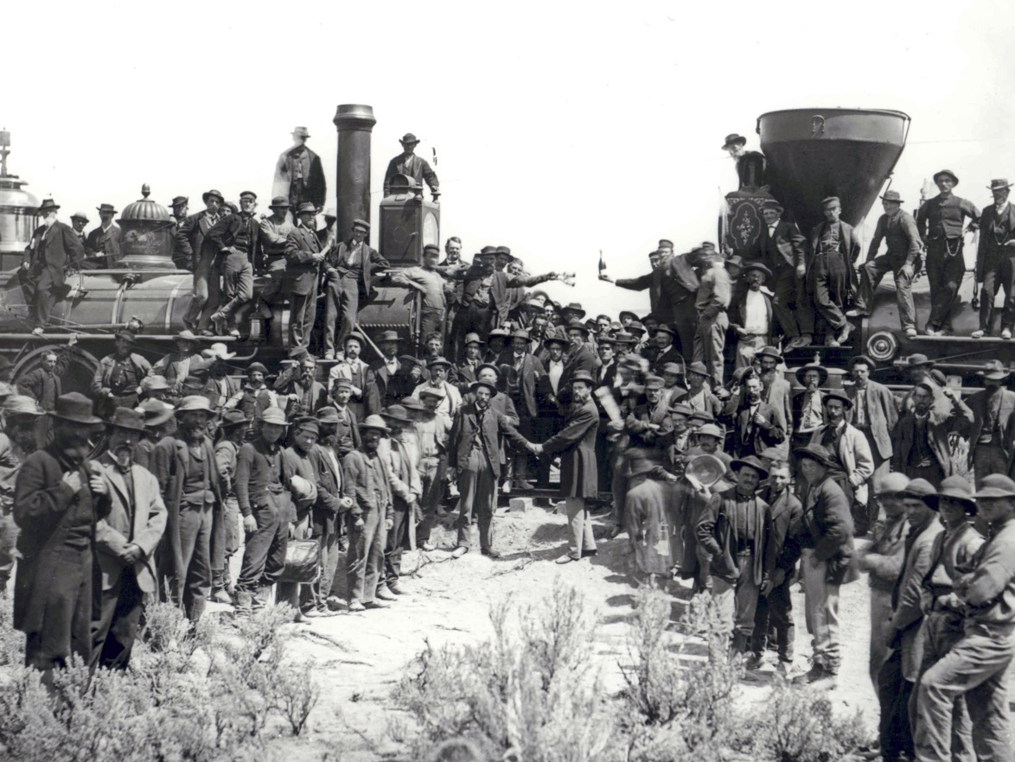
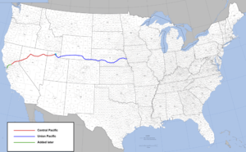
Transcontinental Railroad
Pacific Railroad Act, 1862
Union Pacific
Omaha to the West
Irish
Central Pacific
Sacramento to Sierra Nevada
Chinese
Promontory Point—1869
Golden Spike
Impact:
-Unifies domestic market
-Mass distribution of goods (faster, cheaper)
-Leads to mass production/consumption
-Growth of industry, cities
-Immigration, Migration
-Creation of standard time

Slide 7
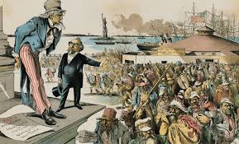
Politics of Gilded Age—Corruption!
Railroad Tycoons—powerful!
Vanderbilt
Captain of Industry or Robber Barron?
Corruption—
Credit Mobilier
Land grants, loans, speculation, etc.
Overproduction, mismanagement
Rebates (discounts) for “friends”
It’s not what you know…
“Pools” form, fix rates—no competition

Slide 8
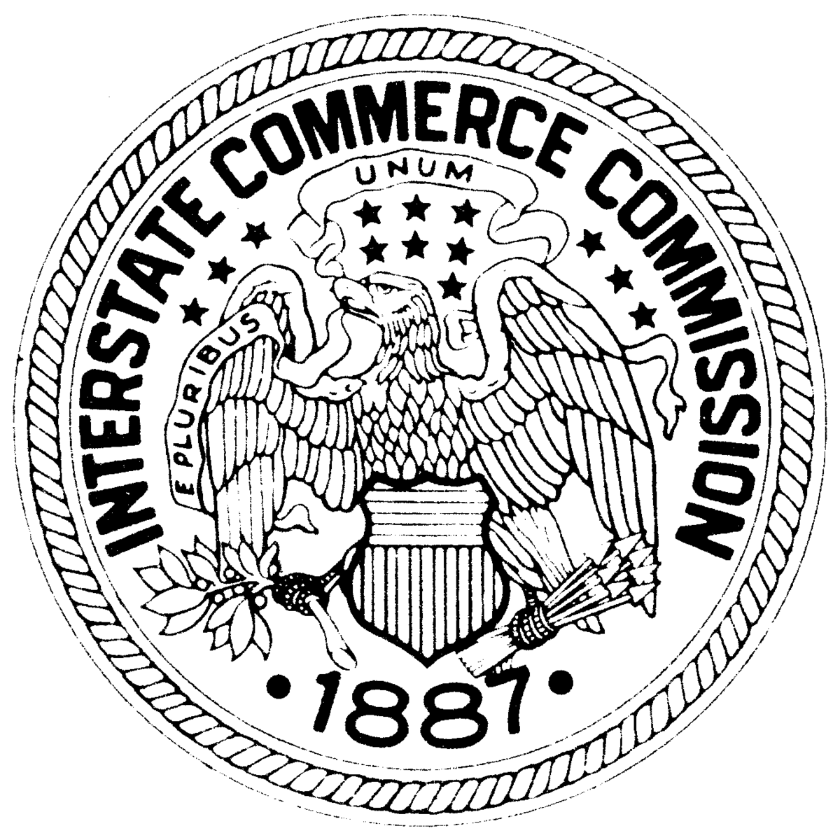
Should the Government Get Involved?
More demands for government interference
Laissez-faire
Grange movement—farmers
Munn v. Illinois—states can regulate business
Wabash Case—states cannot regulate INTERSTATE Commerce
1887—Interstate Commerce Act
Government oversees business
Prohibits pooling, discounts, fixing prices, etc.
Companies must publish rates
-First attempt by federal government to regulate business in the interest of society
-A law with no teeth

Slide 9
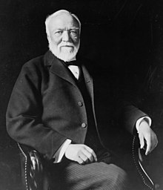
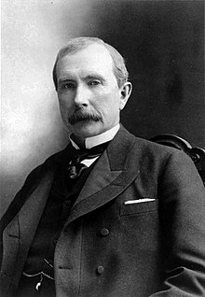
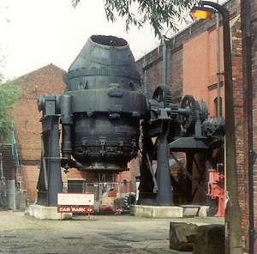
Big Business
In addition to the RR…
Oil**
Rockefeller**
Steel**
Carnegie**
Coal
Captain of Industry,
OR
Robber Barron?

Slide 10
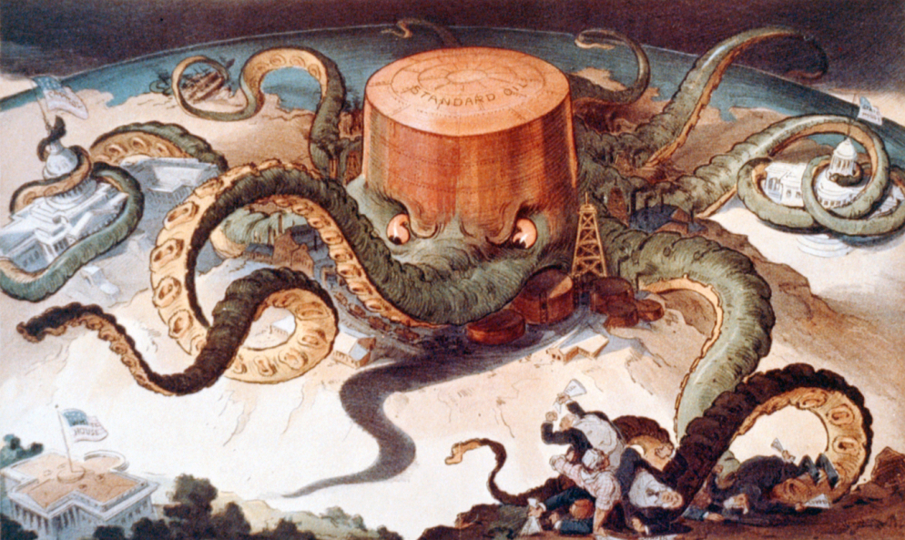
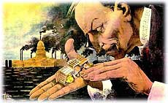

Slide 11
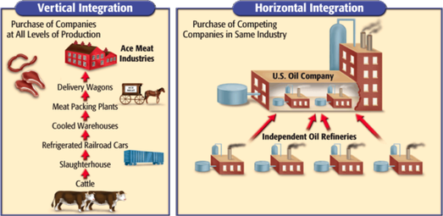
Business Practices
Horizontal Integration
Control all competition in an industry
Merge companies together
Consolidate all competitors
No compaction—monopolize market**
Vertical Integration
Control all aspects of manufacturing
Increase efficiency, control all stages of production

Slide 12
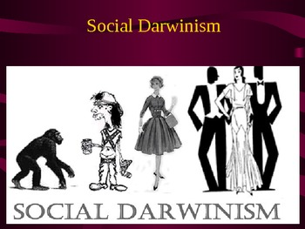
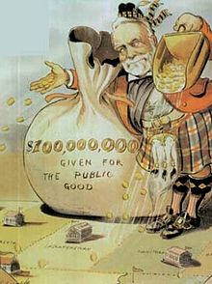
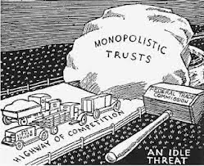
Ideas of Industrial Revolution
Key idea—laissez-faire
Survival of the Fittest / Social Darwinism**
Gospel of Wealth**
Carnegie
Philanthropy**
More calls for regulating business
Sherman Anti-trust Act**
Outlaws trusts / monopiles
Another law with no teeth

Slide 13
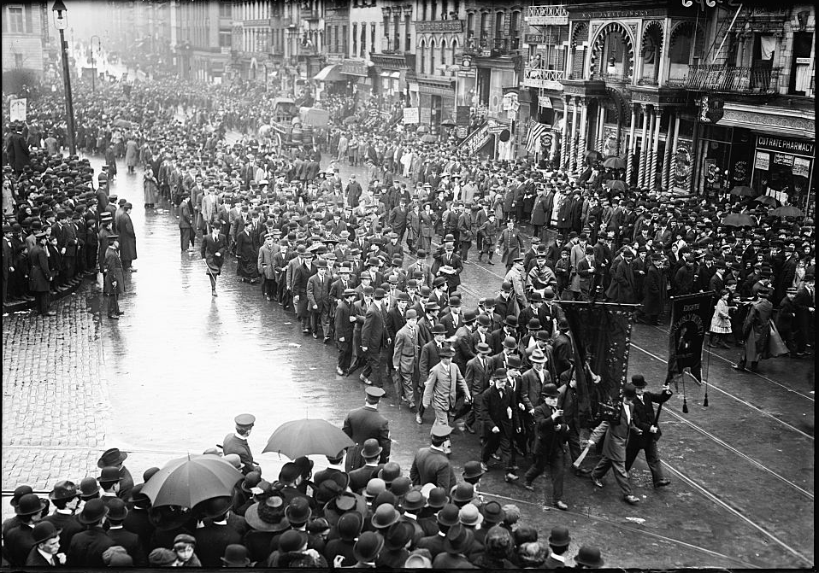
Labor Unions**
Problems for workers**
Wages, hours, conditions, etc.**
“Fix this, or else!”
Unions form to seek to right these wrongs, BUT
Division among workers—skilled vs. unskilled
Racial hostilities—anti immigrant
No protection by government
Courts force workers back on the job
Corporations retaliate
Everyone is replaceable
Yellow-dog Contracts
Blacklisting
Public largely against Unions—socialist, radical

Slide 14
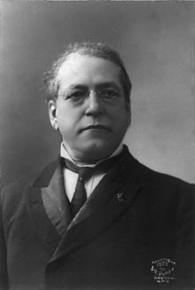
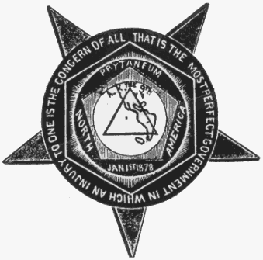
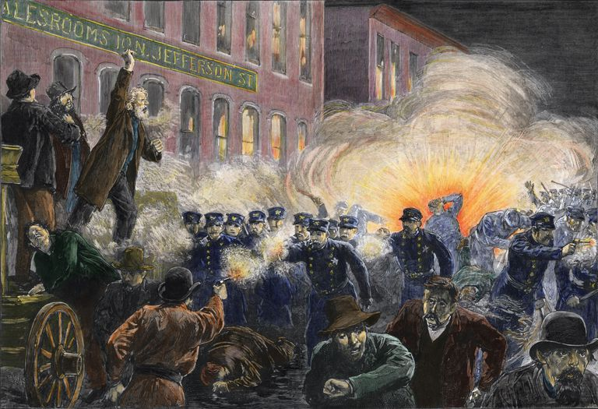
Labor Unions Form
National Labor Union, 1866
Organize workers in all states
Demand higher wages and 8-hour work day
Knights of Labor, 1869**
Terence Powderly
Skilled, Unskilled workers
Women and African Americans
Declines after Haymarket Riot, 1866**
American Federation of Labor, 1886
Samuel Gompers**
“Bread and butter” issues
Focus on wages and conditions, not social inequality
Largest union by 1900

Slide 15
Labor Unrest
Workers upset by conditions
Strike**
Railroad Strike, 1877
Hayes uses federal troops
Haymarket Bombing, Chicago—1886
Anarchists
Labor Union blamed as a whole—setback for movement
Homestead Strike, 1892
Lockout, guards used against steelworkers at Carnegie’s factory (PA)
Although this is an AP class, you are also responsible for a STAAR test in May.
This is always tested. Know it.

